Slide 1
Project C.A.S.P.
Week 6, 3/6/2017
Ryan Tedeschi
Dylan Carson
Chris Bowlen

Slide 2
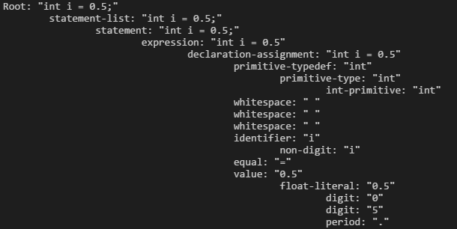
Parses input “int I = 0.5”

Slide 3
DevelopmenT
Dynamic scanner
Compares tokens against structures defined by context free grammar

Slide 4
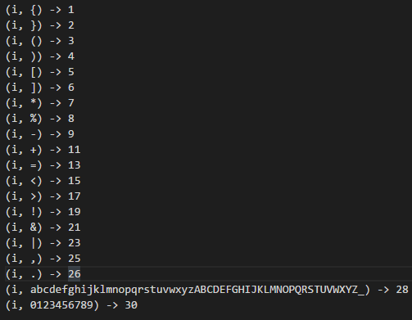
Finite state machine
For sample C++ grammar

Slide 5
Translate
No
File exist check
Yes
Error/output message
Read Lang. File
Not valid
Yes
No
Lang. Serialization
More
Finalizations
End
Place in lookup table
Yes
Lang. obj to construct approx. of target lang. source code.(does the opposite of parse())
Parse into lang. object

Slide 6
Weekly tasks
Ryan and Dylan will implement and test Analyze and translate modules
Dylan and Chris will better outline and pseudocode outline and Lint Modules.

